Slide 1




DYS Dakahlia
Delta Youth Sanad
Ministry of Youth and Sports

Slide 2




Team members
Fatma Alaa Eldin Mahmoud Barakat
Mariam Elsayed Elknany
Alaa Hassan Khalil
Alaa
Sherif Elbadry

Slide 3
1
2
3
4
5
6
7
8
9
10
11
BMC
SWOT
SMART obj
Buyer persona
USP
7 Ps
Calendar
Social accounts and POC
AD (media buying)
Control
Recommendations
Agenda

Slide 4
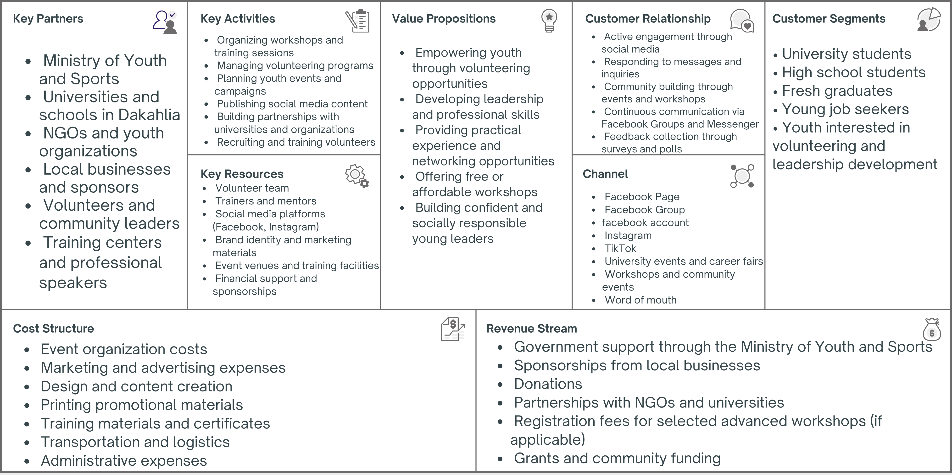
BMC

Slide 5
SWOT
STRENGTHS :
Clear identity as a youth initiative in Dakahlia
Active in offline events and volunteering
Growing presence on Facebook
Engaged audience of students and young professionals
Ability to combine skill development & volunteering program
WEAKNESSES:
Limited reach outside core cities
Low posting frequency on social media
Few short-form videos (Reels) and interactive content
Branding and visuals could be more consistent and professional
Limited marketing budget for paid campaigns
THREATS :
Competition from other youth initiatives and student clubs
Social media attention span is short; high competition for engagement
Limited resources to scale activities quickly
Policy or administrative changes affecting youth programs
Potential decrease in volunteer participation if events not engaging
OPPORTUNITIES:
High youth population interested in skill development
Partnerships with universities, NGOs, and local businesses
Increasing demand for volunteering and community activities
Growing engagement with digital content (Reels, Stories, polls)
Hybrid events (offline + online) to expand audience

Slide 6
SMART
SMART Goal 1
SMART GOAL 3
Increase DYS Dakahlia’s Facebook and Instagram reach by 40%, grow followers by 30%, and improve the average engagement rate by 25% within six months through consistent content publishing, Reels, Stories, and targeted advertising campaigns.
Strengthen DYS Dakahlia’s digital presence by publishing at least 4 social media posts, 3 Reels, and daily Stories every week for six months, while maintaining a consistent visual identity and increasing audience interaction through polls, quizzes, and educational content.
SMART Goal 2
SMART Goal 4
Recruit 300 new volunteers and achieve at least 200 active participants in workshops and community events within six months by collaborating with universities, promoting events on social media, and implementing an effective volunteer recruitment campaign.
Achieve a participant satisfaction rate of at least 90% by collecting feedback after every workshop and implementing continuous improvements throughout the six-month campaign.

Slide 7
Buyer persona

Slide 8
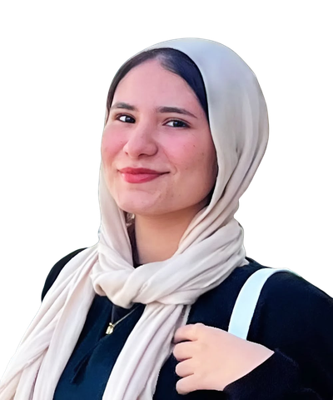
Bio:
Passionate about self-development and volunteering; seeks hands-on leadership roles and workshops to build her CV.
Motivations:
Personal development
Volunteering
Technology and social media
Career growth opportunities
Sara Ahmed
Frustrations:
Limited access to extracurricular activities
Lack of guidance about career paths
Few opportunities for skill development before university
Behavior:
Checks Facebook and Instagram daily
Watches Reels and short videos
Participates in polls and contests
Shares useful posts with friends
Age: 20
Gender: Female
Location: Mansoura, Dakahlia
Goals:
Develop communication and leadership skills
Participate in youth activities and events
Discover future career interests
Build confidence and social connections
Personality: Extrovert, Thinking
University student, Business Administration

Slide 9
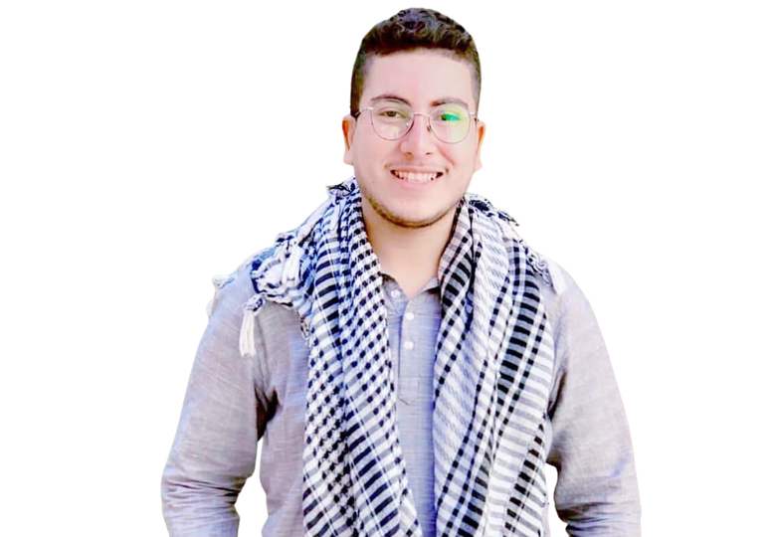
Bio:
Job seeker looking for affordable training and volunteering to bridge the post-graduation gap and boost employability.
Motivations:
Opportunities to gain experience
Networking with motivated youth and professionals
Access to workshops that improve employability skills
Ahmed Hasan
Frustrations:
Lack of practical experience after graduation
Limited access to affordable training programs
Difficulty finding networking opportunities
Behavior:
Active on Facebook and LinkedIn
Watches educational videos and career tips
Searches for job opportunities and training programs
Age: 24
Gender: male
Location: Talkha, Dakahlia
Goals:
Improve professional skills
Build a strong CV
Gain practical experience
Expand professional network
Personality: Introvert , Feeling
Bachelor's Degree in Engineering

Slide 10
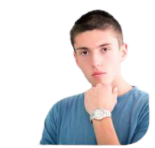
Bio:
Eager to explore future career paths and build social skills through youth activities before starting university.
Motivations:
Opportunity to join youth activities and meet new friends
Learn skills before university
Participate in workshops
Mahmoud Ali
Frustrations:
Limited access to extracurricular activities
Lack of guidance about career paths
Few opportunities for skill development before university
Behavior:
Active on Facebook, Instagram, and TikTok
Watches short educational videos and motivational content
Engages with polls, competitions, and interactive posts
Age: 17
Gender: male
Location: Mansoura, Dakahlia
Goals:
Develop communication and leadership skills
Participate in youth activities and events
Discover future career interests
Build confidence and social connections
Personality: Extrovert, Sensing
High School Student

Slide 11

USP
"Empowering Dakahlia youth through hands-on volunteering, skill development workshops, and leadership opportunities all in one initiative."
Strength
Passion
Unique selling proposi-tions
Market Needs

Slide 12
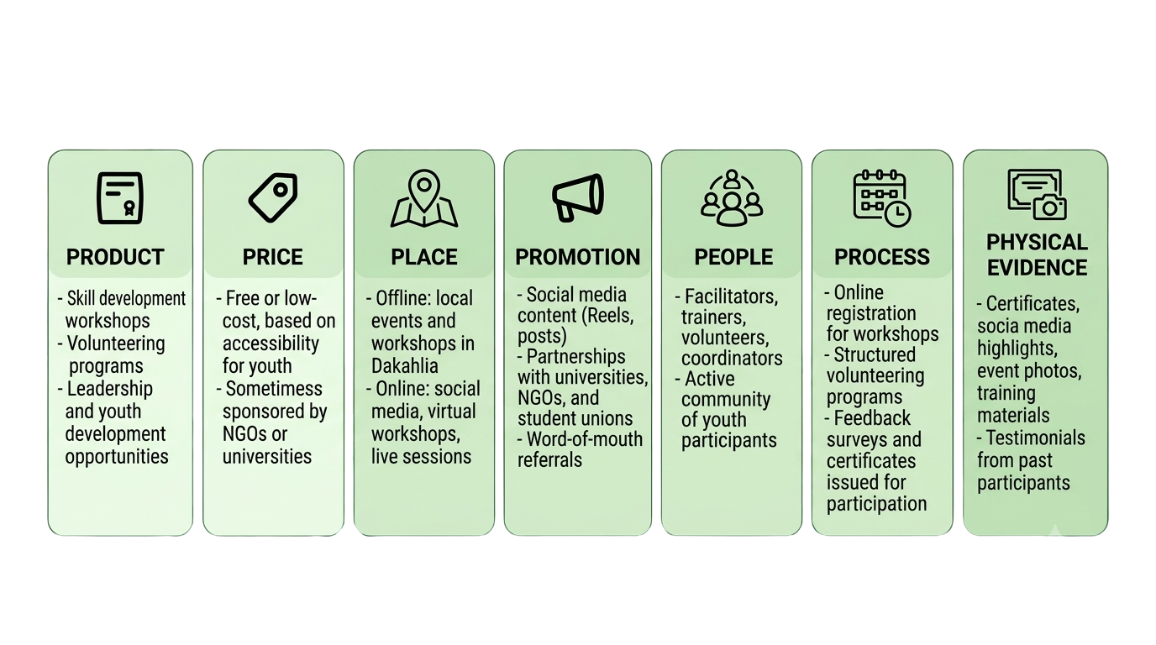
7 PS

Slide 13
Content Calendar

Slide 14









To
15-3-2026 15-4-2026
Awareness
Celebration
Sun | Mon | Tue | Wed | Thu | Fri | Sat
15-3 |  | 17-3 | 18-3 |  | 20-3 | 21-30
 | 23-3 |  | 25-3 |  | 27-3
29-3 |  |  | 1-4 | 2-4 |  | 4-4
5-4 |  | 7-4 | 8-4 |  | 10-4
12-4 | 13-4 |  | 15-4
Visuals
Storytelling
Emotional
Collaboration
Fun
Engagement
Recruitment

Slide 15
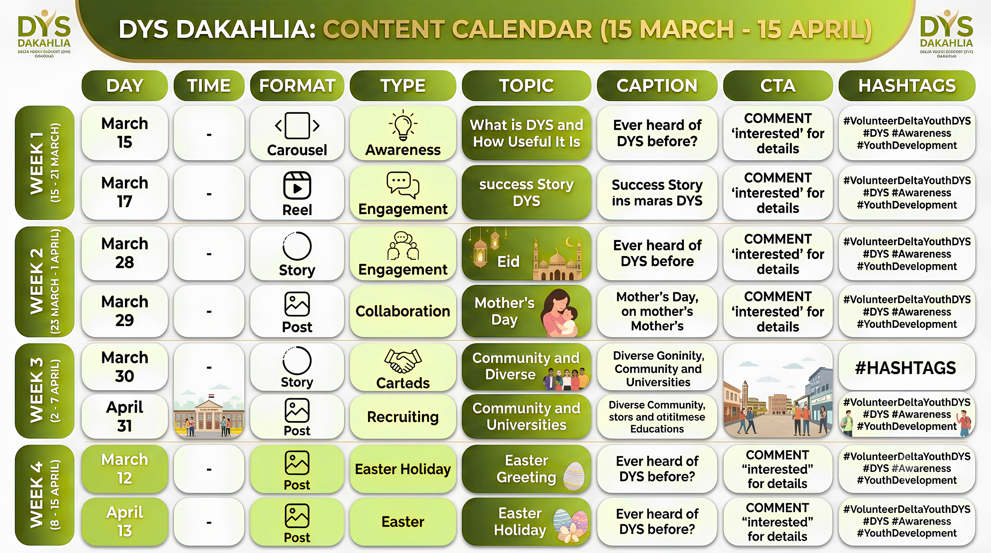
15-3-2026 15-4-2026
To

Slide 16


MAY
2026
Awareness
Sun | Mon | Tue | Wed | Thu | Fri | Sat
 |  |  |  |  | 1-5
 | 4-5 |  |  | 7-5
 | 11-5 |  |  | 14-5
 | 18-5 |  |  | 21-5
24-5 |  | 26-5 | 27-5 | 28-5 |  | 30-5
31-5
Celebration
Visuals
Inspiration
Emotional
Engagement
Loyalty

Slide 17
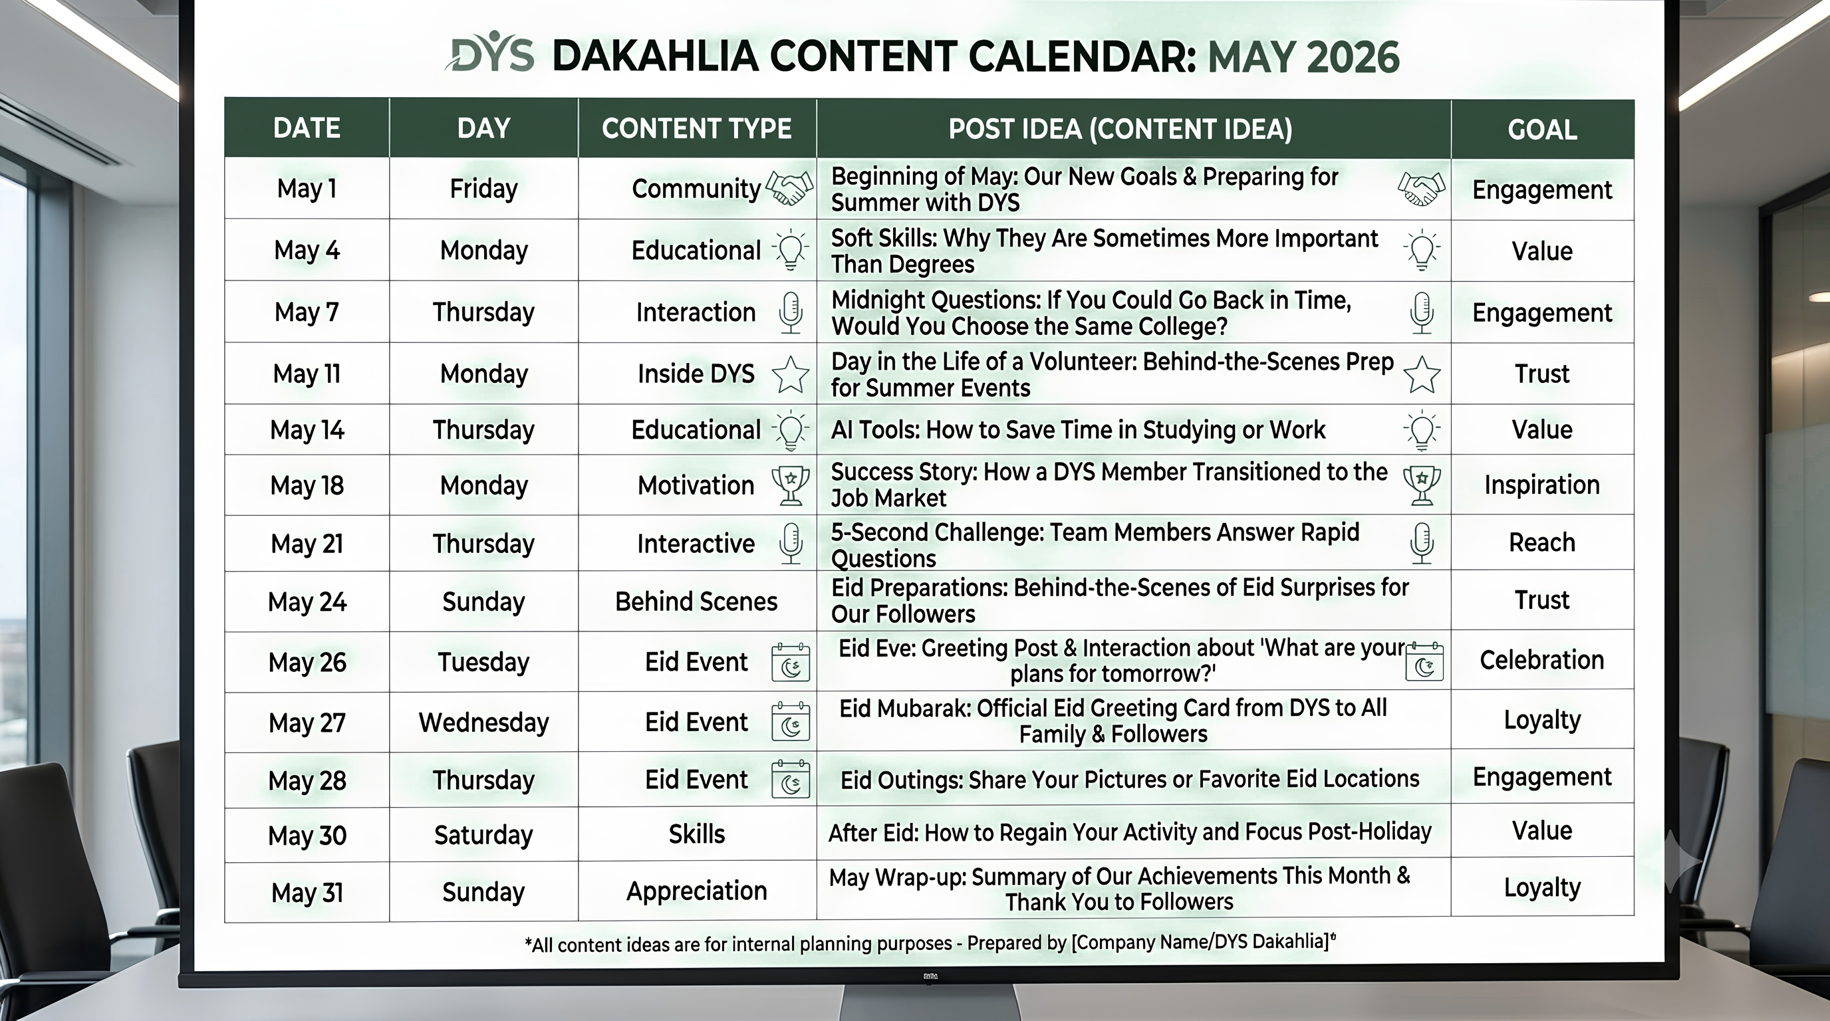
MAY
2026

Slide 18
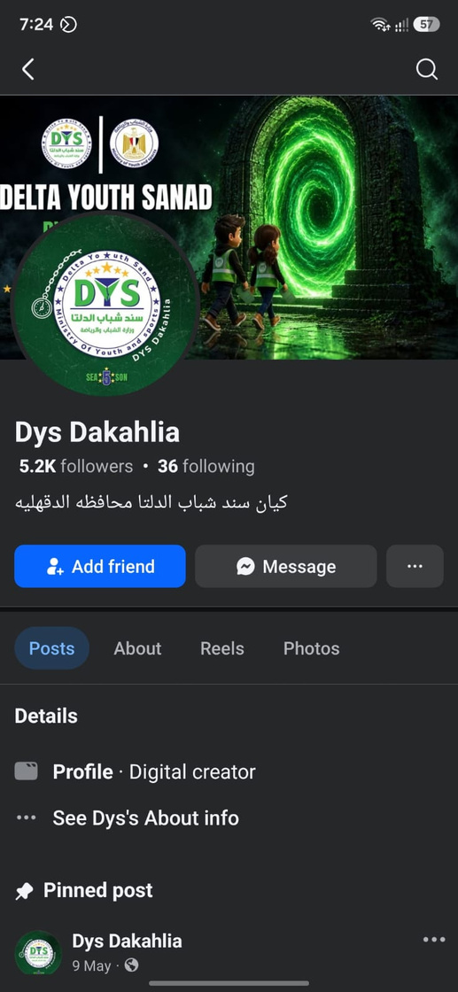
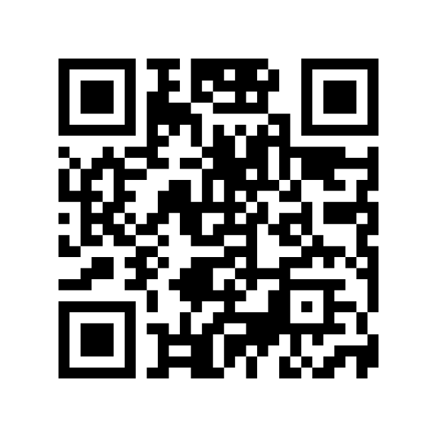
Social Account
Facebook Account

Slide 19
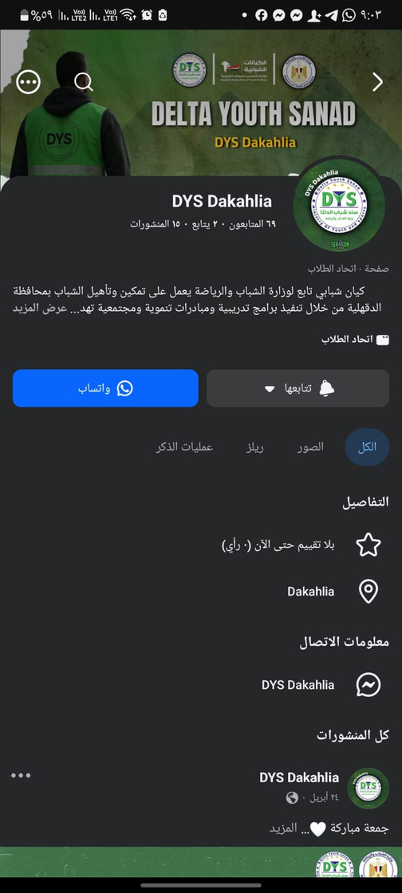
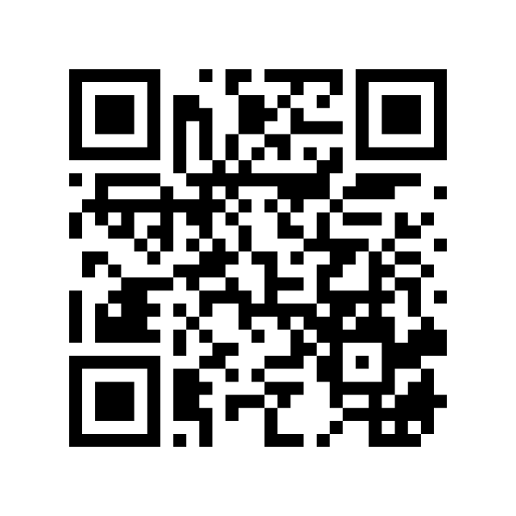
Social Account
Facebook page

Slide 20
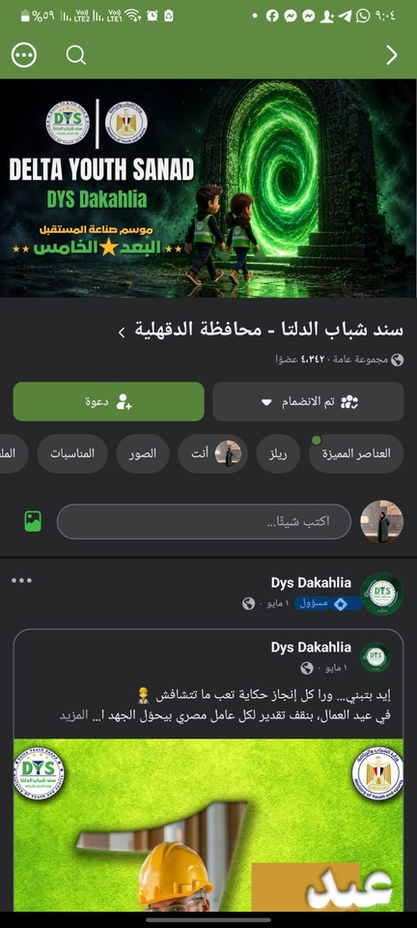

Social Account
Facebook group

Slide 21

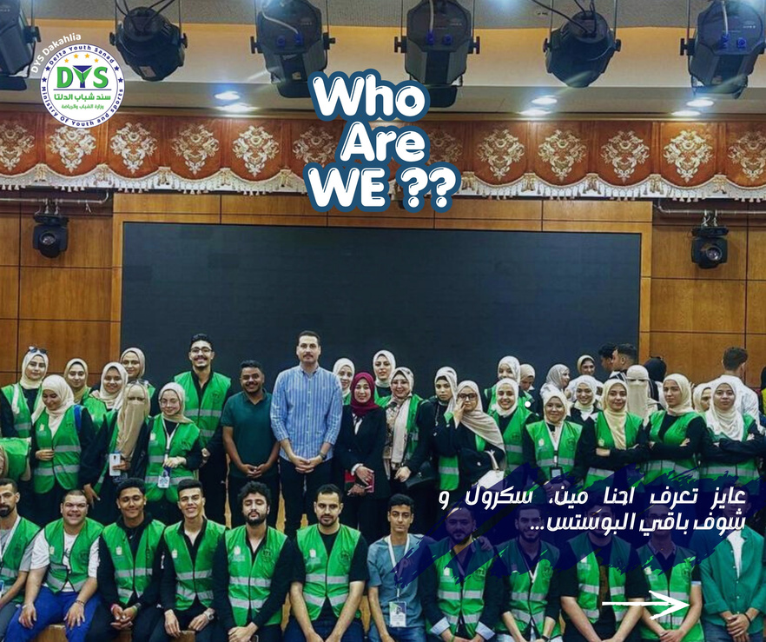
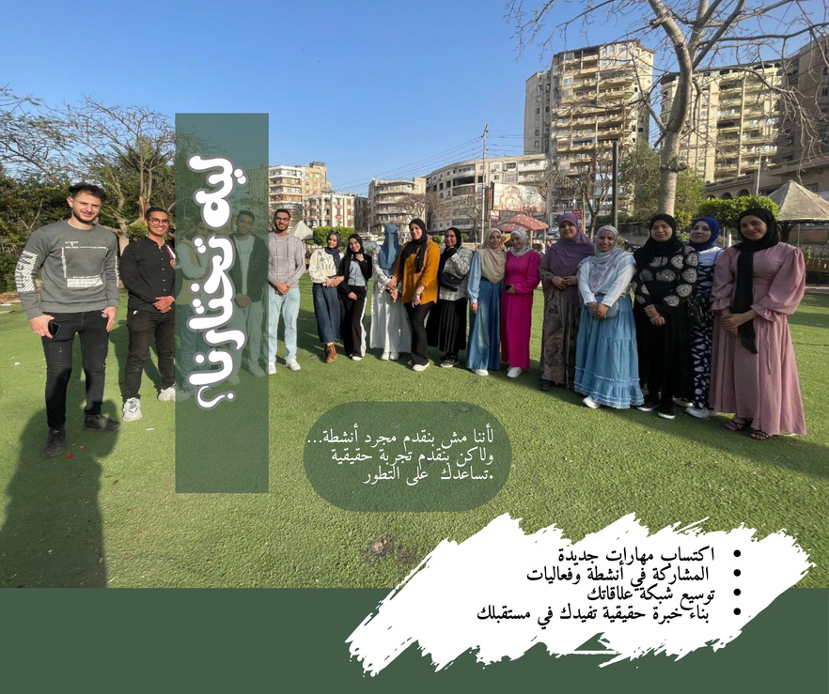



Posts

Slide 22

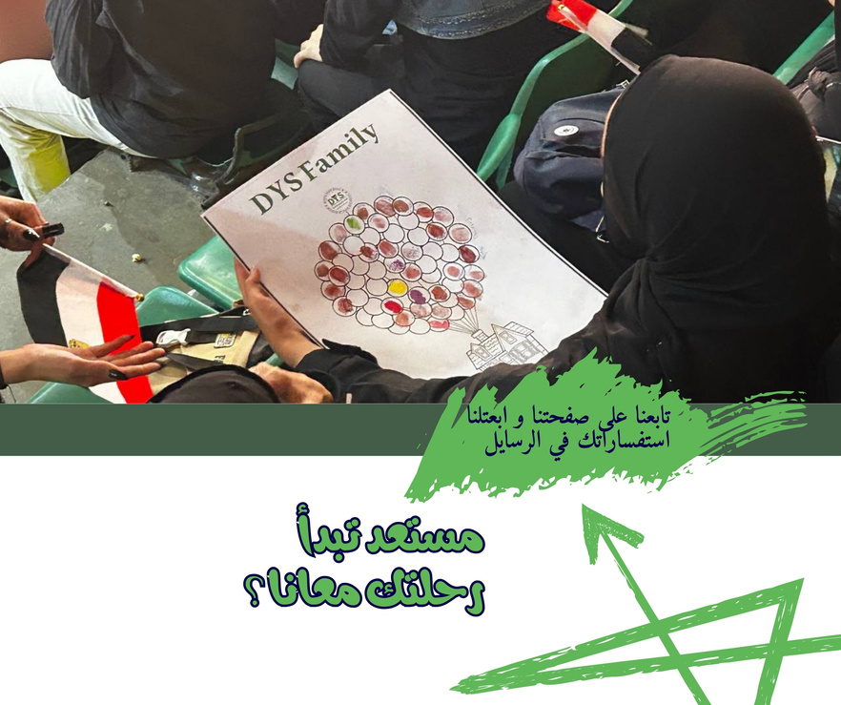
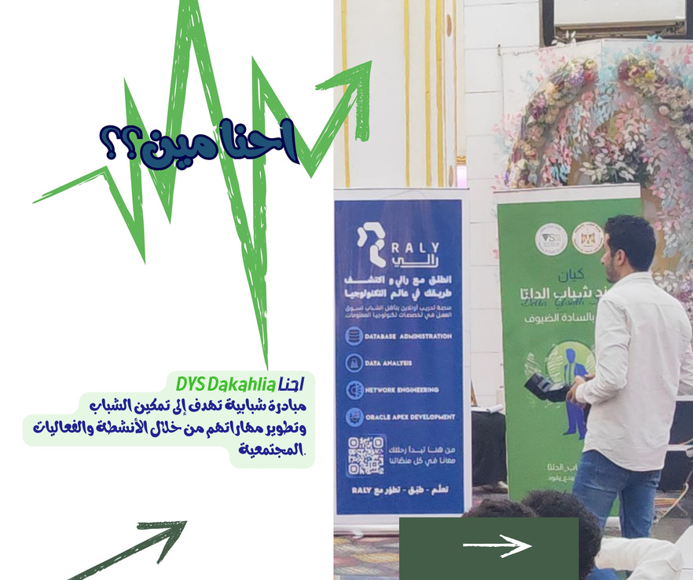
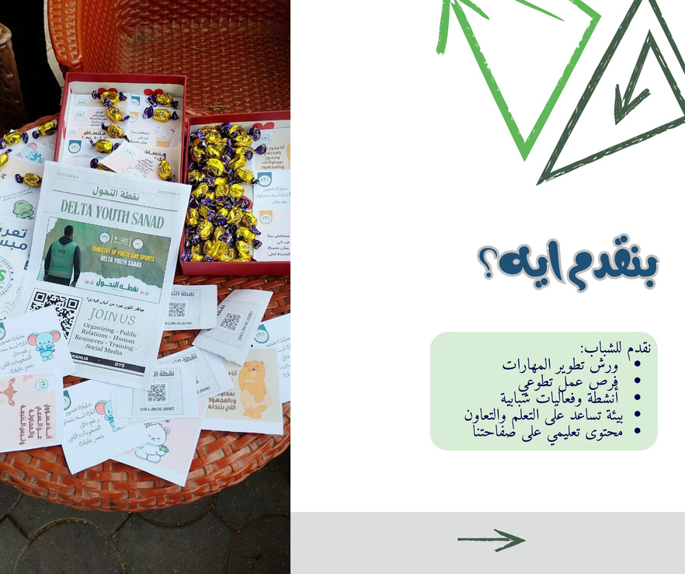
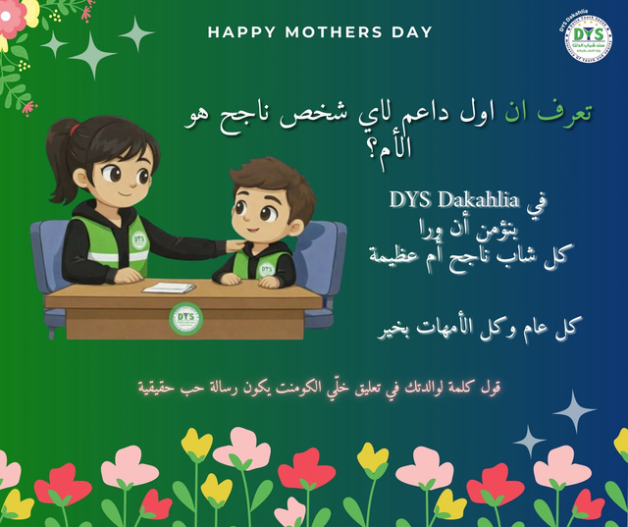
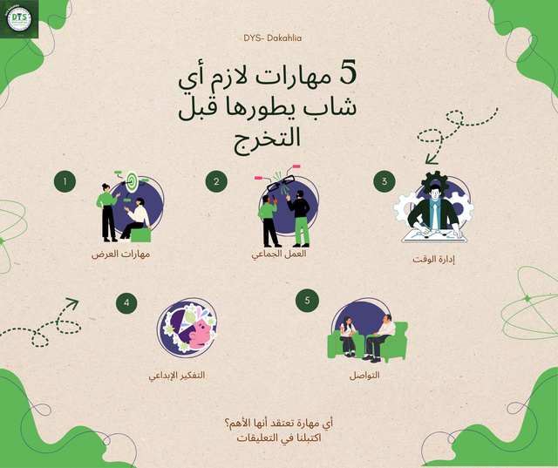
Posts

Slide 23

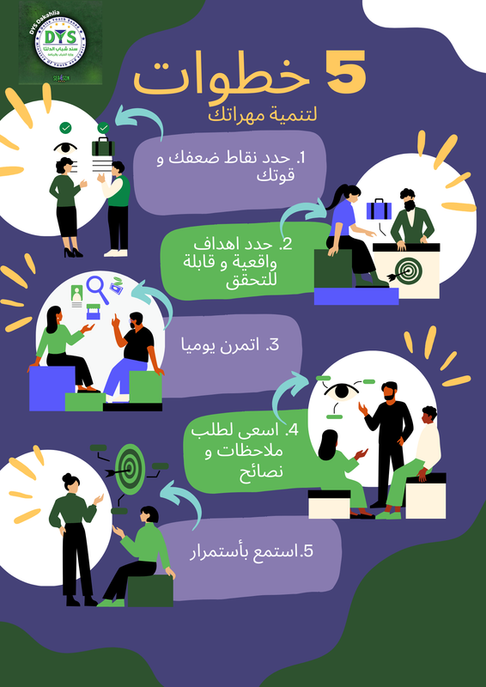

Posts

Slide 24
ADs
(Media Buying)

Slide 25
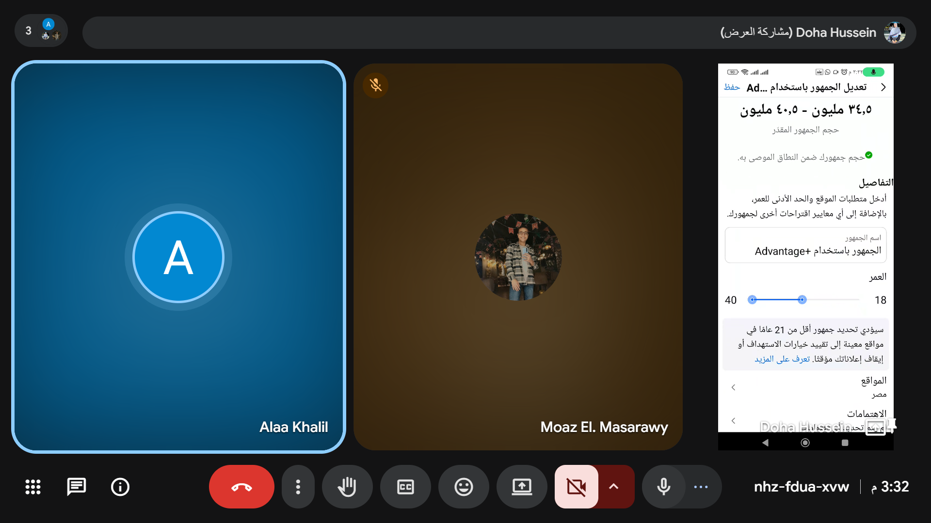
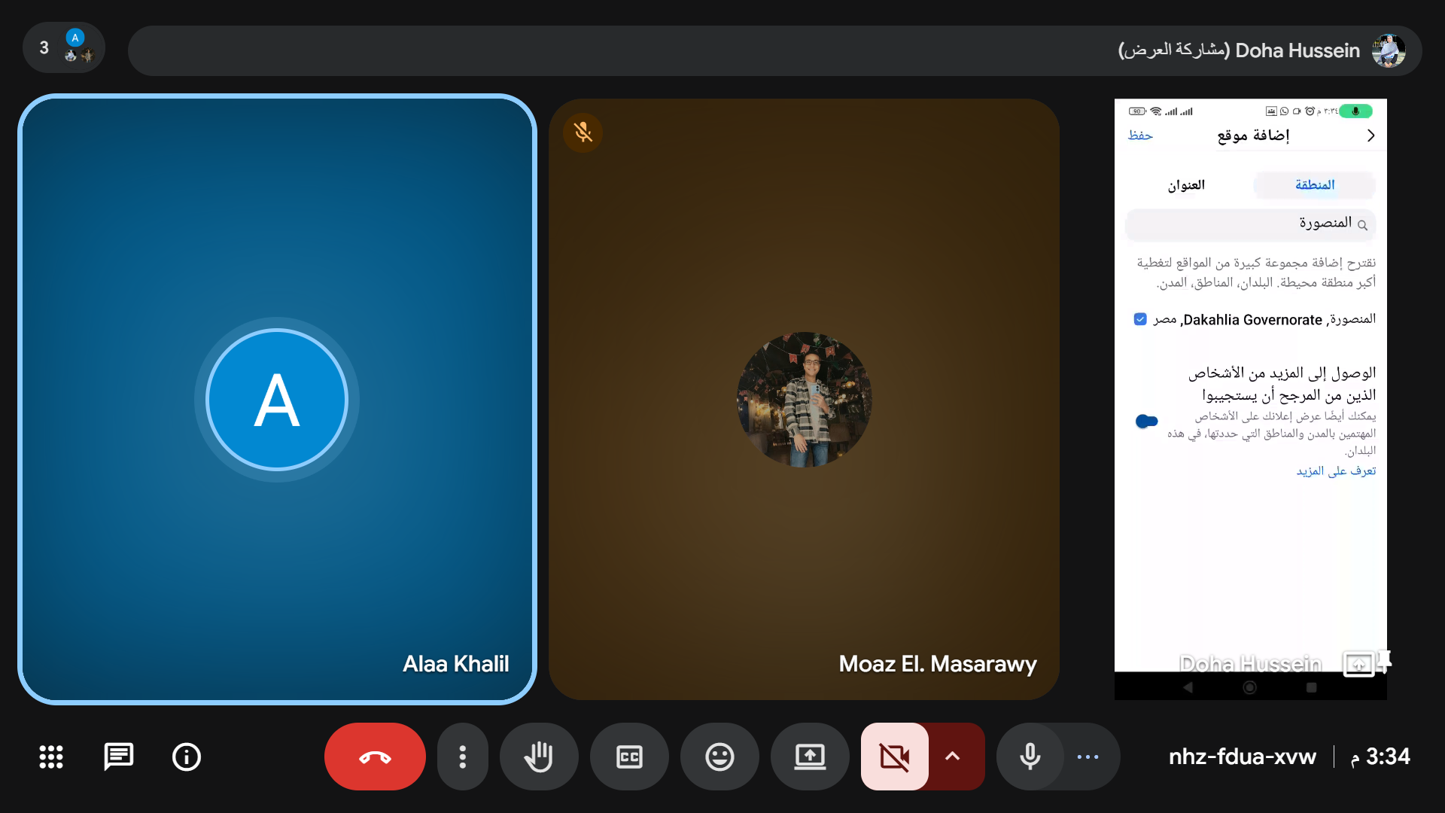
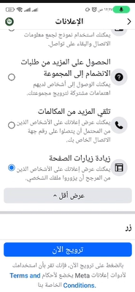
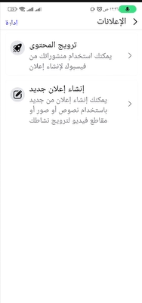
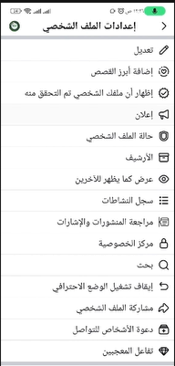
ADs

Slide 26
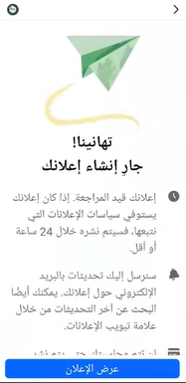
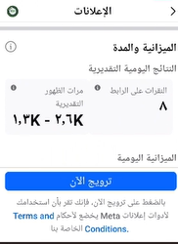
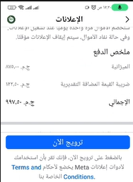
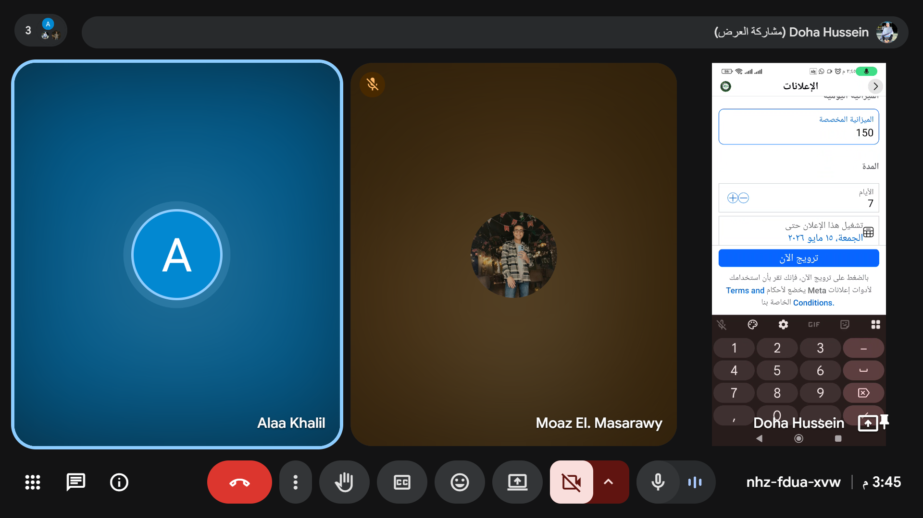
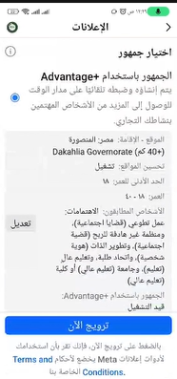
ADs

Slide 27
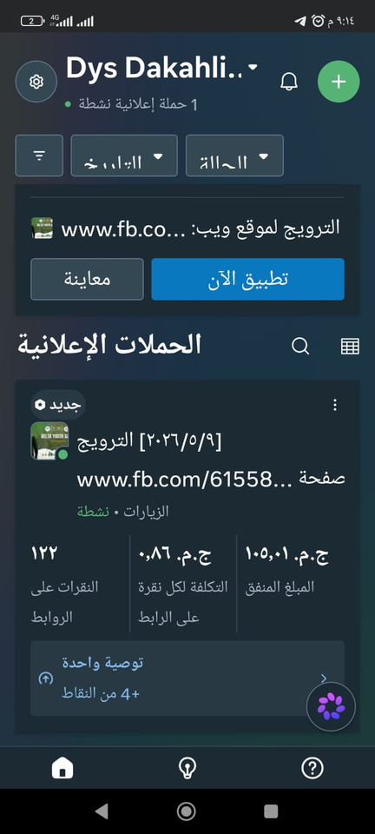
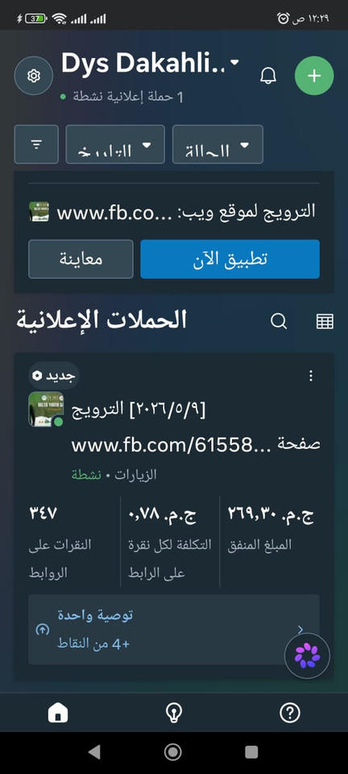
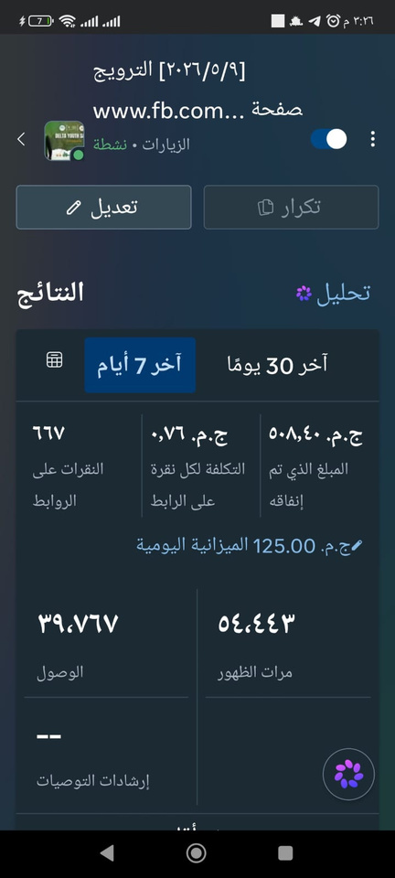
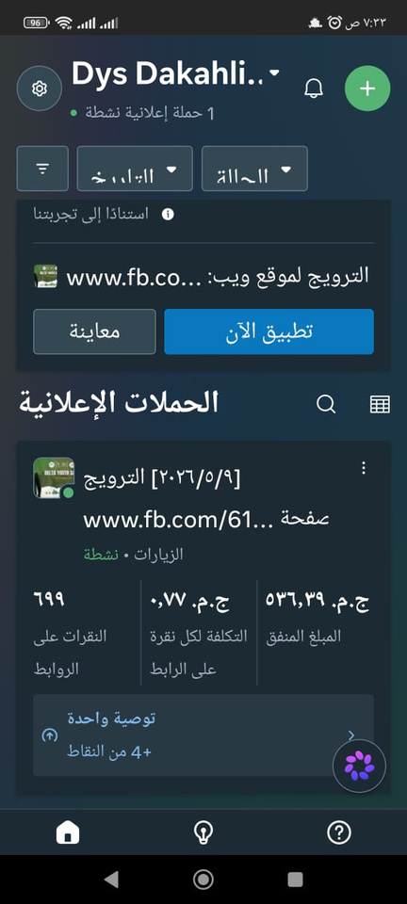
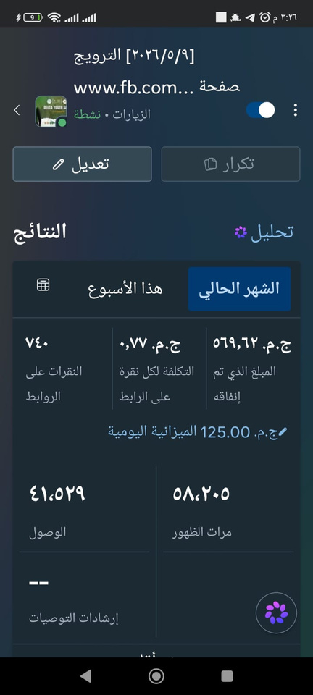
ADs

Slide 28
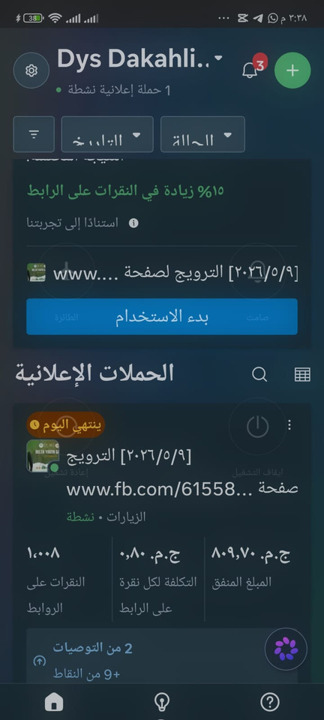
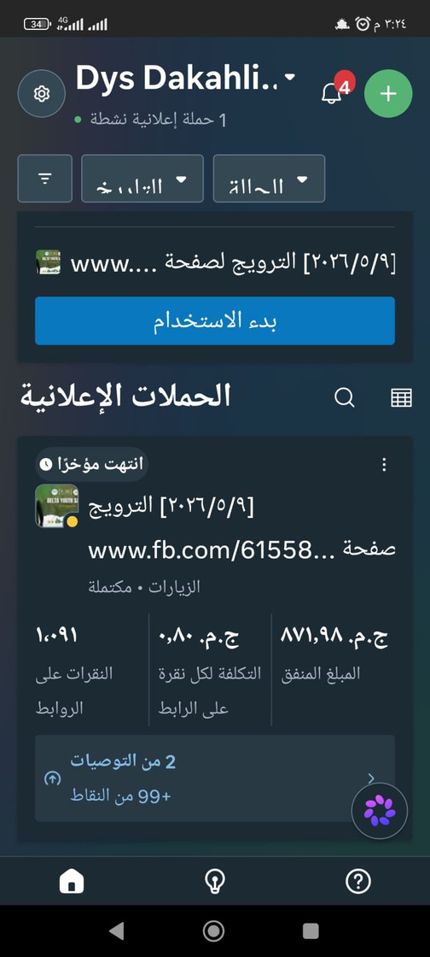
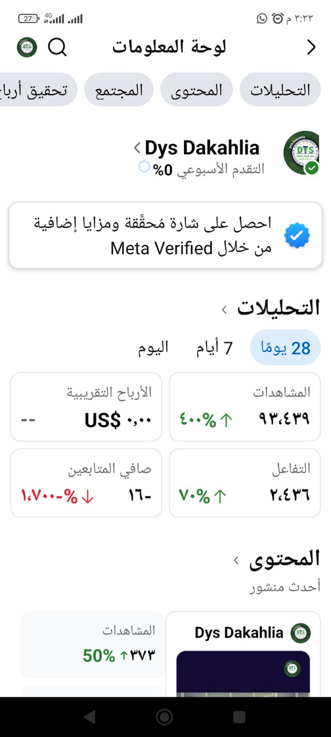
ADs

Slide 29
Control
Monitoring Methods:
Track Facebook and Instagram analytics using Meta Business Suite.
Monitor reach, engagement, follower growth, and video performance every month.
Collect participant feedback through surveys after each workshop or event.
Compare actual results with SMART objectives and adjust the marketing strategy when needed.
Review the content calendar monthly to identify the best-performing content types.

Slide 30
Develop a Consistent Content Calendar, Publish 4–5 posts and at least 3 Reels per week to maintain audience engagement and improve page visibility.
01
Increase the Use of Short-Form Videos, Create educational and behind-the-scenes Reels showcasing workshops, volunteering activities, and success stories to increase organic reach.
02
Recommend-ations
Improve Visual Branding, Use a consistent color palette, typography, and design style across all posts to strengthen the page’s identity and professionalism.
03
Post More Interactive Content, Use polls, quizzes,
“Did You Know?” posts, Q&A sessions, and discussion questions to encourage comments and shares.
04
Highlight Success Stories, Share testimonials
and achievements of volunteers and participants to build trust and inspire new members to join.
05

Slide 31
Monitor Performance Using Analytics, Track key performance indicators (KPIs) such as reach, engagement rate, follower growth, and event registrations to evaluate content effectiveness and improve future campaigns.
06
Optimize Messenger Communication, Implement a professional automated Messenger system with quick replies to frequently asked questions and registration guidance.
07
Recommend-ations
Strengthen Partnerships, Collaborate with universities, student organizations, NGOs, and local businesses to expand the initiative’s reach and attract new participants.
08
Promote Events More Effectively, Announce events in advance, post countdown reminders, and share highlights before, during, and after each event.
09
Invest in Targeted Advertising, Allocate a small advertising budget to promote important campaigns, volunteer recruitment, and major events to the target audience in Dakahlia.
10

Slide 32
THANK YOU

